Slide 1


So what is Automated Learning?

Slide 2
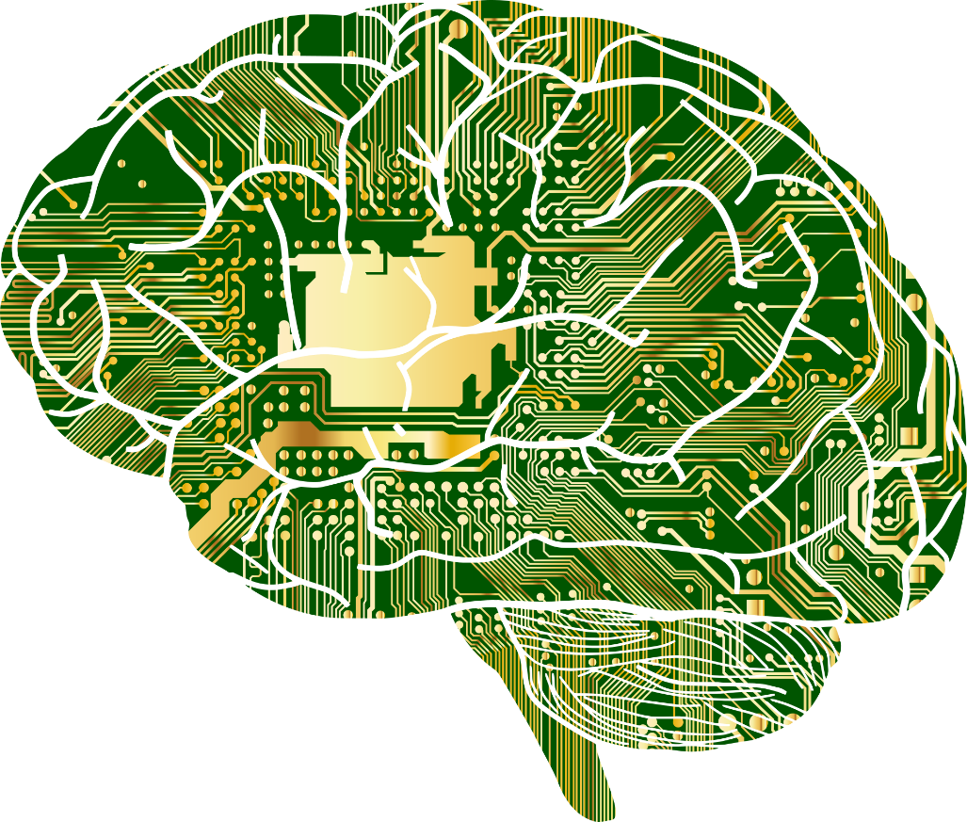
Automated Decision Making
Machine Learning is concerned with making optimal decisions primarily using the tools of statistics.
Biased cognitive process
Biased input data
Decisions & Predictions
Data (feature values, measures, outcomes…)
$$E=\{\left(x_{1},y_{1}\right),\left(x_{2 }, y_{1}\right), …, (x_{n}, y_{1})\}$$
Notes:
How does this view of human knowledge and decision making relate to automated machine learning. Well, machine learning algorithms actually make decisions similarly to humans. This means they are subject to the same problems of bias, and flawed decision making. However the means by which this happens is quite different.
This is because Machine Learning is concerned with making optimal decisions primarily using the tools of statistics.
Artificial systems receive features taken from sensors (e.g. cameras, microphones etc.) or data from some other computational/record system that keeps track of information. Much like in humans, where experiences are associated with outcomes, the input features are associated with some outcome\label. This is represented by the set $E$.
To make decisions and predictions using this information, machine learning uses statistics. This type of mathematical decision making uses only the evidence available. You may think that this makes automated learning immune to bias. This is unfortunately not the case. Machine learning can be just as fallible for two main reasons.

Slide 3
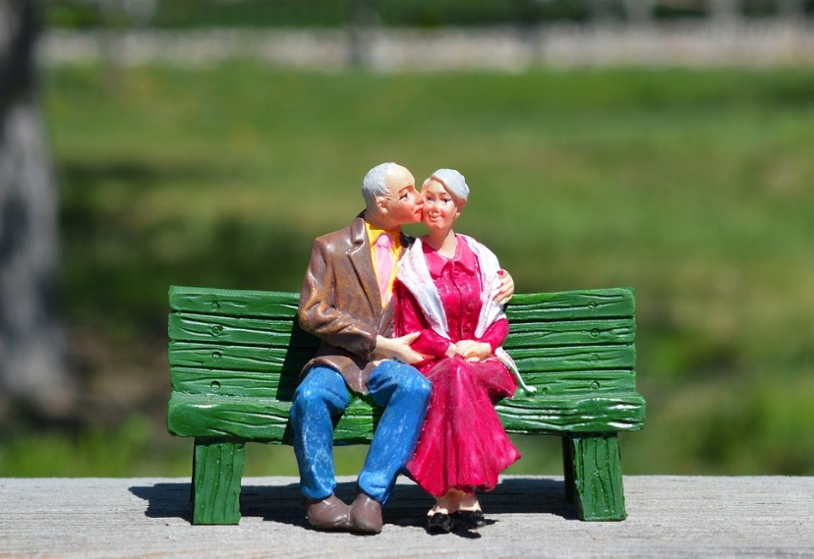

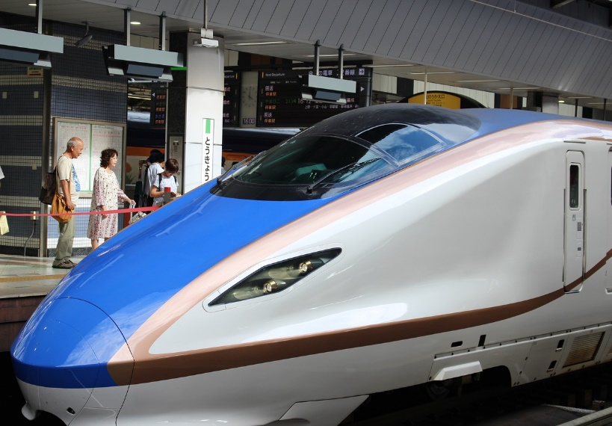
Automated Decision Making’s Flaws
Biased cognitive process - For instance suppose we try to teach an algorithm to predict when a train on the Tokyo rail network will be late.
Trains on this network are exceptionally punctual.
To achieve the best overall performance, just never predict that a train will be late.
Biased input data - For example, suppose you want to teach an algorithm to recognize a specific disease in a group of patients.
You provide the algorithm with data describing patients who are all aged between 60 to 80.
You then run the algorithm on patients aged 18 to 30. The algorithm performs badly, as it’s knowledge is biased toward recognizing disease in much older patients.
Notes:
The first reason automated decision making can be flawed - biased input data. For example, suppose you want to teach an algorithm to recognize a specific disease in a group of patients.
You provide the algorithm with data, which just so happens to describe patients aged between 60 to 80.
You then run the algorithm on patients aged 18 to 30. The algorithm performs badly, as it’s knowledge is biased toward recognizing disease in much older patients.
The second reason is biases in the cognitive process. For instance, suppose we try to teach an algorithm to predict when a train on the Tokyo rail network will be late.
Trains on this network are exceptionally punctual.
To achieve the best overall performance, just never predict that a train will be late.

Slide 4
Making Optimal Automated Decisions
Algorithms can process more quantifiable data than humans.
However the data may be biased/incomplete.
Individual algorithms also have intrinsic biases.
Algorithms can therefore be just as fallible as humans!
Available
Knowledge &
Experience
Knowledge / Experience
captured by data
Knowledge / Experience
captured by features
2
4
Knowledge / Experience
captured by algorithm used to make a decision
3
5
Set of all knowledge
on subject A
1
Notes:
We’ve reviewed some of the issues faced when trying to learn using machine learning. Lets recap:
Algorithms can process more quantifiable data than humans. They can process entire databases or libraries of information, if it is presented in the right way.
However the data may be biased/incomplete. We must ensure the data we give to our algorithms is not biased, or incomplete such that it can give a misleading impression.
Individual algorithms also have intrinsic biases. We must keep that in mind when considering what we are trying to do with machine learning.
Algorithms can therefore be just as fallible as humans! There are many examples of this. In truth our algorithms are only as good as we make them. Thus in reality poor automated decision making reflects our own deficiencies more than anything.
Lets bring this together. Here the blue box labelled 1, represents the set of all knowledge of some subject available. This is an idealised set that contains every piece on information available which may be stored in books, web resources or in the minds of other people.
The circle labelled 2, represents the portion of that knowledge that is available to an algorithm. It is an incomplete portion, thus it is a subset of the knowledge available. It is incomplete for many reasons. For instance, available data hasn’t been digitised, or features are yet to be designed and extracted. We already have a gap in our knowledge at this step.
The circle labelled 3 represents the data that has been digitised and turned into features.
Then there is the knowledge and experience captured by the features, represented by circle 4 . Features are not perfect; knowledge is lost here.
Finally there is the knowledge and experience captured by the algorithm from the feature data. This is represented by the circle labelled 5.

Slide 5

From Experience to Training Data
Experience is known as "training data".
An algorithm is ‘taught’ using training data.
Training data can be labelled or unlabelled.
We evaluate performance on a disjoint dataset called "test data" - this data must be labelled (ground truth known).
$$Training data=\{\left(x_{1},y_{1}\right),\left(x_{2 }, y_{1}\right), …, (x_{n}, y_{1})\}$$
Notes:
In machine learning the experience used by an algorithm to learn is known as "training data".
An algorithm is ‘taught’ using training data. It uses the examples and labels in the training data, to solve problems using the tools of maths and statistics.
Training data can be labelled (see the notes for Part 1, Slide 7) or unlabelled (see the notes for Part 1, Slide 9), which is something we learned in Part 1 of the module.
To check that our algorithms have successfully learned what we wished them to from the training data, we must test them. To do this we evaluate them on a new set of data. We call this "test data”.
Test data must be labelled (that is, the ground truth must be known). Test data must also be distinct from training data. This is crucially important. Doing this helps ensure that our algorithms don’t overfit to the training data – much like the student in Part 1 of the module that failed their exam (see the notes for Part 1, Slide 16).

Slide 6
Training vs Test Data
There is an easy way to understand the difference between training and test data.
Training data represents the knowledge given before an exam.
Test data is a disjoint set of information, that represents the exam – we use this to test performance.
Training
Set of all knowledge
on subject A
Test
Notes:
There is an easy way to understand the difference between training and test data.
Here the blue box represents the set of all knowledge of some subject available. This idealised set that contains every piece on information available which may be stored in books, web resources or in the minds of other people.
Training data represents the knowledge given before an exam.
Test data is a disjoint set of information, that represents the exam – we use this to test performance.

Slide 7
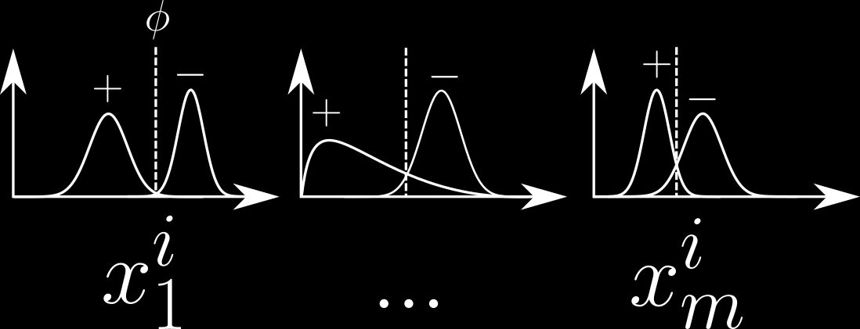
Features & Labels Revisit
Features (Variables)
$x_{i}$ = {$x_{i}^{1}$ , …, $x_{i}^{m}$ }
Height
Mass
Age
Labels ( Feedback )
$$y_{i}∈\{−1, 0, 1 \}$$
e.g. -1 = no disease etc
$$Training data=\{\left(x_{1},y_{1}\right),\left(x_{2 }, y_{1}\right), …, (x_{n}, y_{1})\}$$
Notes:
Whilst humans can automatically extract sophisticated features to make decisions, our artificial analogues are much less capable.
Generally, we must extract features for them. Whilst a human can look at an animal and automatically assess it’s mass (approximately), we must give the artificial system the mass value directly. But how is this information used?
In humans, you can scan your experience and consider examples of animals with similar masses, to an unknown animal currently in front of you.
Artificial systems instead compare the mass value against a numerical distribution (stored in $E$) describing the mass values for all the animals previously observed. It can then connect the distributional information to the labelled feedback at it’s disposal - I.e. choose a label appropriate for an animal of this mass.
There are some methods that can extract features for themselves. However this is an advanced topic that may be covered in future modules.
We must also provide useful labels in the training and test sets – again these are designed by us to achieve some specific purpose.
Feature design and extraction is an important and necessary step that must be taken, before we create our training sets. You may wonder how to design features, or if there’s some accepted process for doing so?

Slide 8
Feature Design
In principle feature design involves studying your data.
Considering it’s properties.
Extracting information you believe will help with class separation.
In practice this involves,
considering as many candidate features as possible.
Considering their useful ness in turn.
Selecting a sub-set of features you think will be effective.
Testing those, see what happens.
Return to step 1 if results are not as expected.
Collect new data?
Deriving new features?
Height
Mass
Age
Notes:
In principle feature design involves studying data.
This requires thinking about it’s properties. What is the “information content” of the features? For example, when classifying mammals and birds, using a feature such as “number of eyes” may not be useful – all have 2. Such a feature has low information content. We desire features with high information content.
Extracting information you believe will help with class separation. Features with high information content help with class separation. A feature such as mass will have higher information content when trying to separate birds and mammals then “number of eyes”. Though the feature “has feathers”, is of much high information content – it can be used to perfectly separate the two groups.
In practice feature design involves,
1. Considering as many candidate features as possible. Collect all the features you could use.
2. Considering their usefulness in turn.
3. Selecting a sub-set of the best features that you think will be most effective.
4. Testing those selected, and checking what happens when we use them to train and test a classifier.
5. The features chosen may turn out to be poor. So we may need to return to step 1.
6. Collect new data? Maybe the data you have is simply not good enough.
7. Deriving new features? Perhaps the features you have a poor, but can they be combined in some way that makes them useful? Can you think of a feature that would be useful for separating Felines and Canines? What about a feature that equals mass divided by height – would that be useful?
Not all Felines are small, and not all Canines are large. So this is unlikely to be as effective as we’d like. What about a body length divided by tail length? Do Felines have longer tails relative to their bodies then Canines? Have a think about these questions in your own time.

Slide 9
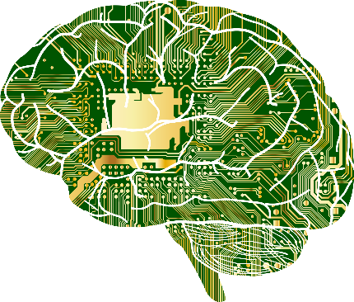
Classification Process
$$E$$
Test
Set
= {($x_{1}$,$y_{1}$), …, $(x_{n}\text{,}y_{n})$}
Mammals
Training
Set
= {($x_{1}$,$y_{1}$), …, $(x_{n}\text{,}y_{n})$}
Extract
$$?$$
Learn / Evaluate
Features
Predict
Birds
$x_{i}$ = {$x_{i}^{1}$ , …, $x_{i}^{m}$ }
Input
Data
Labels
= {($x_{1}$), …, $(x_{n})$}
$$y_{i}∈\{−1, 0, 1 \}$$
Features
Extract
$x_{i}$ = {$x_{i}^{1}$ , …, $x_{i}^{m}$ }
Predictions
= {($x_{1}$, $y_{1}$), …, $(x_{n}\text{,}y_{n})$}
Notes:
We’ve covered a lot of material so far. We’re now ready to review the whole classification process.
First we’re given a data set relating to some problem we wish to solve.
We design and extract features from this dataset.
This allows us to form a training set that we can use to teach a machine learning algorithm. We can also form a test set that we use to evaluate what the algorithm has learned. When satisfied that the algorithm has learned effectively, we can move on.
We’re then given a new data set of unseen examples, that are not accompanied by labels. The ground truth is not known.
We extract features from this dataset. These are the same features we extracted when forming the training set.
We collect this new input data, and pass it to our machine learning algorithm. We ask it to make some predictions on this input dataset.
The algorithm outputs the input data but with true class labels – these are the predictions.

Slide 10
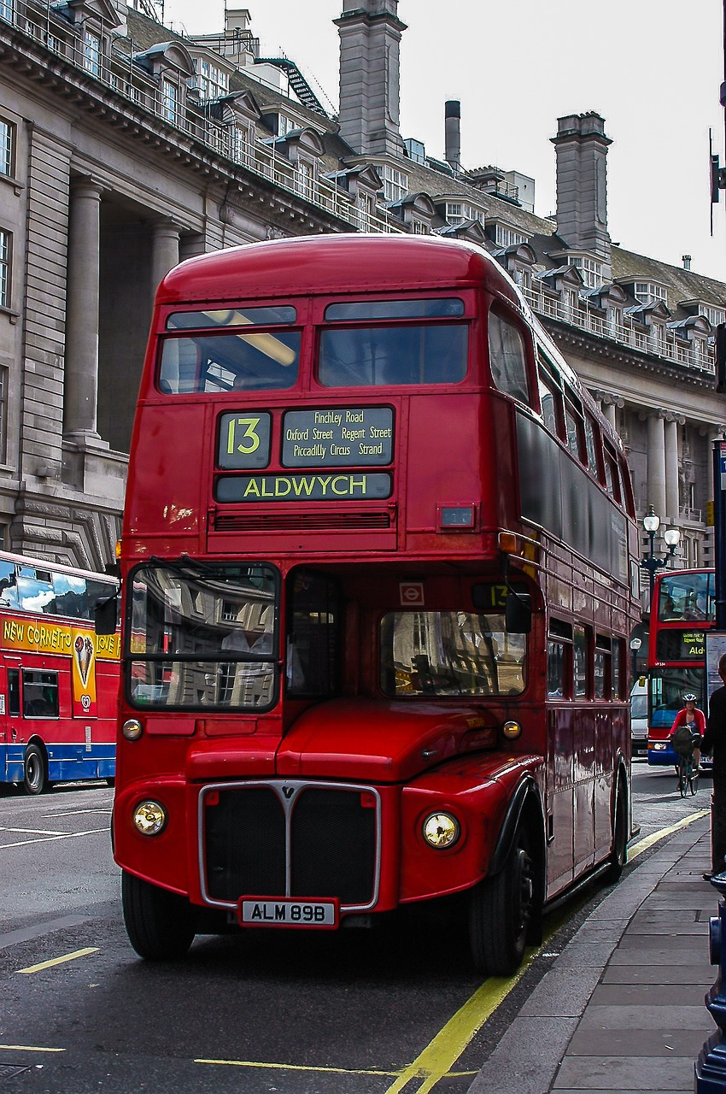
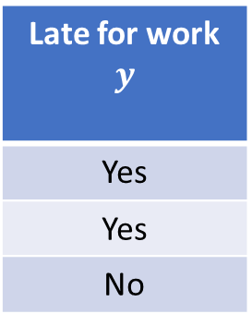
So How is “Learning” Done?
Learning via trial and error – learning from mistakes made.
We need to be at work, but don’t know what time the bus arrives to get us there. Work starts at 09:00, and the journey takes roughly 40 minutes.
We start to wait at the bus stop each day, recording some details.
Day | Arrived at bus stop | Bus arrived
Mon | 08:32 | 08:45
Tue | 08:17 | 08:30
Wed | 08:12 | 08:15
Late for work $$y$$
Yes
Yes
No
In this case learning involves finding an arrival time at the bus stop, that lets you make it to work on time. Each time you’re late, you’ve made an error that you learn from.
Notes:
So far we’ve learned all about the process of learning, but not how it’s actually done.
In machine learning this is achieved via trial and error on the training set – learning from the mistakes made. This is best understood via an example.
We need to be at work, but don’t know what time the bus arrives to get us there. Work starts at 09:00, and the journey takes roughly 40 minutes.
We start to wait at the bus stop each day, recording some details.
Here we see some data recorded over three days. It shows what time we arrived at the bus stop, what time the bus arrived at the bus stop, and whether or not we were late for work. This represents training data. Each row represents a trial, and the label lets us know if we made it to the bus stop early enough.
In this case learning involves finding an arrival time at the bus stop, that gets us to work on time. Each time we’re late, we’ve made an error that we learn from.

Slide 11
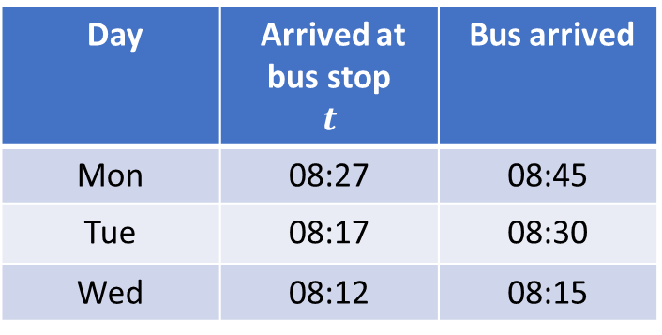
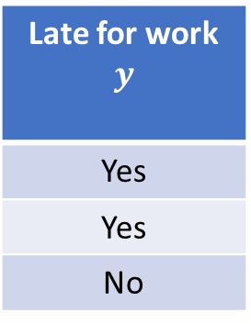
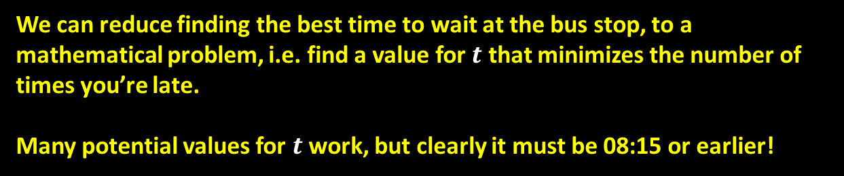
So How is “Learning” Done?
In ML error is quantified and minimised using the tools of mathematics.
This sort of error minimisation is done using functions.
We can reduce finding the best time to wait at the bus stop, to a mathematical problem, i.e. find a value for $t$ that minimizes the number of times you’re late.
Many potential values for $t$work, but clearly it must be 08:15 or earlier!
Day | Arrived at bus stop $$t$$ | Bus arrived
Mon | 08:27 | 08:45
Tue | 08:17 | 08:30
Wed | 08:12 | 08:15
Late for work $$y$$
Yes
Yes
No
Notes:
In ML error is quantified and minimised using the tools of mathematics.
We can reduce finding the best time to wait at the bus stop, to a mathematical problem, i.e. find a value for 𝒕 that minimizes the number of times we’re late.
Many potential values for 𝒕 work, but clearly it must be 08:15 or earlier!
This sort of error minimisation is done using what we call “functions”. Before proceeding, I advise that you watch the tutorial video (11 minutes long) which I provide the link to in the notes:
https://www.youtube.com/watch?v=52tpYl2tTqk

Slide 12
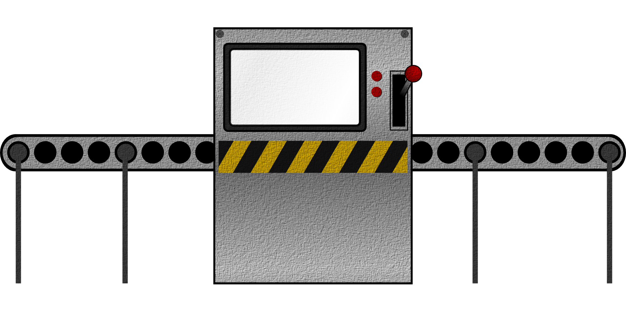

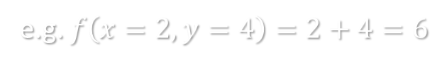
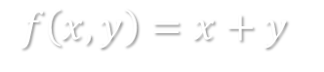
Functions
Functions can be thought of as simple input/output boxes.
Machine learning algorithms are functions that ingest data, and produce some output.
How they do this is hard to convey without some basic mathematics!
Parameters
Outputs
$f\left(x,y\right)=x+y$
e.g. $f\left(x=2,y=4\right)=2+4=6$
Notes:
Functions can be thought of as simple input/output boxes.
Machine learning algorithms are functions, or combinations of many functions, that ingest data, and produce some output.
How they do this is hard to convey without some basic mathematics!
For instance here is a function that accepts two inputs, $x$ and $y$. It returns an output value that is simply equal to $x$ plus $y$.
If we have $x=2$ and $y=4$ this function simply returns an output value of 6.

Slide 13
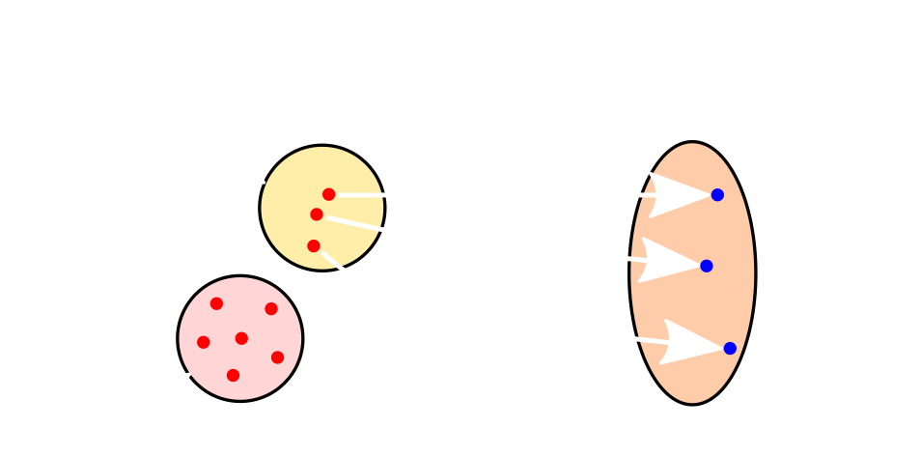
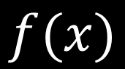
Functions That “Map”
E.g.
Labelled
Observations
$f\left(x\right)=0$, $if feature_{1}≤0$
Data without labels
$1$, $otherwise$
$${feature}_{1}$$ | $${feature}_{2}$$
7.4 | 29
6.6 | 24
3.1 | 11
… | …
0.5 | 2
$$f(x)$$
$$y$$
$$y$$
1= Diabetic
1= Diabetic
0 = Non-diabetic
…
Unknown
$$x$$
Notes:
Suppose we have some input data that contains features describing patients that recently had a blood test.
We desire a function that can accurately assign labels to patients indicating whether or not they’re diabetic.
What we need is a mapping function. This is a function that maps input values in $X$, to the correct labels in $Y$.
A simple function would be something that splits the data on a single feature. For example, if the value of feature 1 is less than or equal to 0, then predict 0 which is the non-diabetic label, otherwise predict 1. Here learning involves finding a feature, and a split value over that feature, that achieves the fewest errors possible.

Slide 14
Decision Stump
$$x$$
$$if age≤34$$
$$if age>34$$
Predict
no diabetes
Predict
diabetes
Predict
no diabetes
Predict
diabetes
We’ve just covered our first ML algorithm - the “Decision stump”.
It is a linear separator, or a linear model.
It simply looks for a feature to split on, in a optimal way.
It produces a linear separator between two classes.
Notes:
We can visualise the method used to split this data using the age feature.
Either assign the diabetic label if age is less than or equal to 34….
Otherwise predict non-diabetic.
This example may seem entirely contrived. However we’ve actually just encountered our very first machine learning algorithm. It’s called a “Decision Stump”.
A Decision Stump is a linear separator, which can also be described as a linear model.
It simply looks for the best feature to split upon, based on the information in the training set. It uses the labels in the training set to guide the feature search, and to find the best split value.
The Decision Stump produces a single linear separator. This means it is only useful for problems where there are two classes which may be separable using a linear decision boundary.

Slide 15
Decision Stump
For each feature in the data, the stump will search for a split-point, that minimises the error rate.
In our example we used age as a feature, and our threshold = 34.
$$x$$
$$if age≤34$$
$$if age>34$$
$x$=34
Predict
diabetes
Predict
no diabetes
Mistakes
made
$$0$$
$$x$$
Notes:
The learning process for the decision stump is simple.
For each feature in the data, the stump will search for a threshold across all features, that minimises the error rate.
We can see how the stump makes fewer and fewer errors, as it moves toward the optimal split value.
In our example we used age as a feature, and our split-value = 34. There are better ways to split this data accurately. However, the Decision Stump is too simple to find those solutions. Only more complex methods that produce non-linear decision boundaries, can solve this problem.

Slide 16
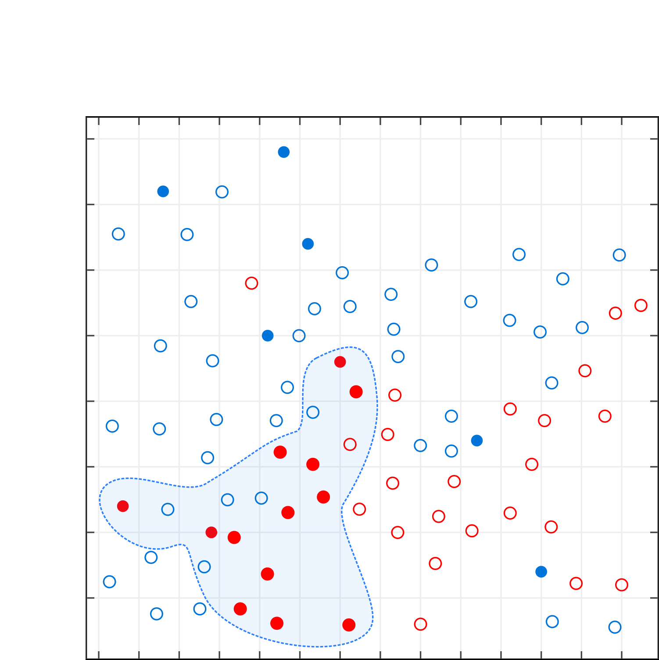
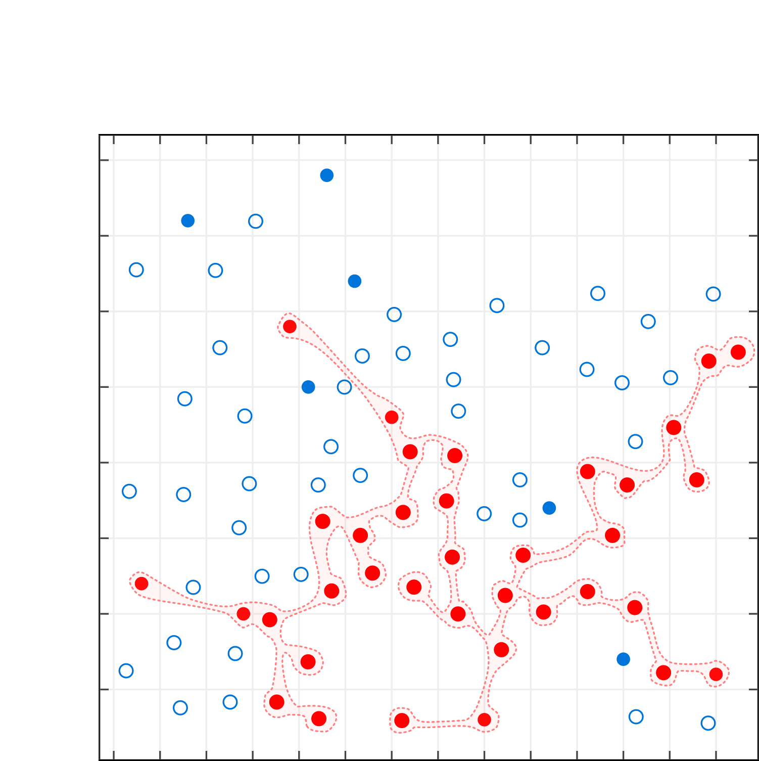
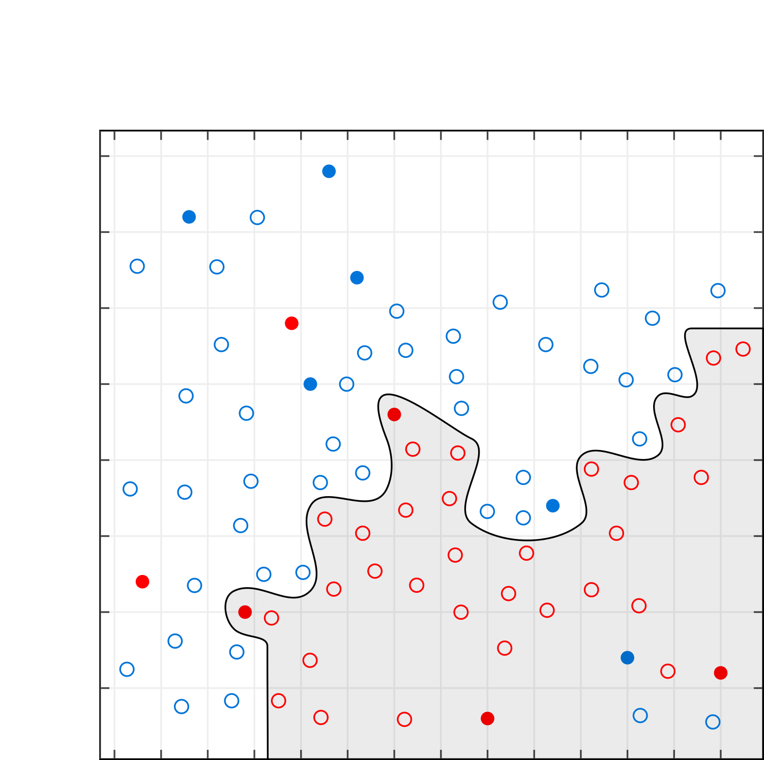
Decision Boundary
Shaded region predicts diabetes
You’ve now seen a linear model in action, and learned what a decision boundary is.
Real-world problems are complex - so too are the decision boundaries needed to accurately separate data.
This means linear models don’t always work well. More complex ML algorithms are required.
When we generalise well we can produce effective decision boundaries.
However sometimes we don’t perform well in practice.
We can underfit to our data.
We overfit to our data.
Decision boundaries allow us to visualise this happening.
Notes:
You’ve now seen a linear model in action, and learned what a decision boundary is.
Real-world problems are complex - so too are the decision boundaries needed to accurately separate data.
This means linear models don’t always work well. More complex ML algorithms are required. The image to the left visualises the same patient data before using different features. We can see a decision boundary represented by the black line, that effectively classifies the data. The data points that fall within the shaded region are classified as diabetic, all other data points are labelled non-diabetic. This boundary achieves optimal accuracy on the training data.
When we generalise well we can produce effective decision boundaries such as this.
However sometimes we don’t perform well in practice.
We can underfit to our data (see the notes for Part 1, Slide 17). Here we can see a new decision boundary represented by the dashed blue line. Now examples falling into the blue shaded area are classified as diabetic, and all other data points as non-diabetic.
We overfit to our data (see the notes for Part 1, Slide 17). Here we can see a new decision boundary represented by the dashed red line. Now examples falling into the red shaded area are classified as diabetic, and all other data points as non-diabetic. This boundary achieves perfect accuracy, but this will not transfer well to new data.
Decision boundaries allow us to visualise this happening, so we can guard against it. Ideally we need boundaries that generalise well to new data.

Slide 17
Learning in Name Only…
What we’ve talked about so far - this isn’t really learning right?
It’s a search for parameters that minimise some error rate.
Learning effectively reduced to a parameter search!
When this works well it provides the illusion of intelligence – but this isn’t how you or I learn.
Notes:
What we’ve talked about so far - this isn’t really learning right? We can’t say that decision stumps really learn at all.
Instead we’ve reduced learning to a search for parameters, that minimise some error rate.
Learning effectively reduced to a parameter search!
When this works well it provides the illusion of intelligence – but this isn’t how you or I learn. Lets carry on and consider some other classification algorithms.

Slide 18
Classification Algorithms
Classification algorithms come in all shapes and sizes.
Inside they are comprised of functions, that attempt to perform the mapping from to in different ways.
What they have in common:
$$x$$
$$y$$
(Examples to labels)
All are evaluated against some feedback metric, which guides their learning - call this the error rate.
They must choose (find) parameter values that minimise the error rate.
Notes:
Classification algorithms come in all shapes and sizes.
Despite their differences, inside they are comprised of functions that attempt to perform the mapping from examples to labels. They mostly differ in how that mapping is actually done.
What they have in common:
All are evaluated against some feedback metric, which guides their learning - call this the error rate.
They must choose (find) parameter values that minimise this error rate.

Slide 19
Classification Algorithms

Slide 20
Types of Classifier
Discriminative
Generative
Learns the differences between the examples in a training set.
Use those differences to classify and make predictions.
We often think similarly, like in the Fossa example.
Learns a “model” of the classes in the training set.
This model can be then compared against.
We don’t usually think this way, e.g. given all the cats we’ve seen, what is the probability that this animal is a cat?
Notes:
There are two main types of machine learning classifier. Discriminative approaches, and Generative approaches.
Discriminative methods learn the differences between the examples in a training set.
They use those differences to classify and make predictions.
We often think similarly, like in the Fossa example.
Generative methods learn a “model” of the classes in the training set.
This model can be then compared against.
We don’t usually think this way, e.g. given all the cats we’ve seen, what is the probability that this animal is a cat?
There is an example in the notes that may help you better understand the difference between these approaches.

Slide 21
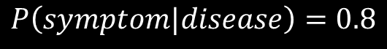
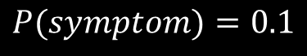
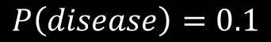
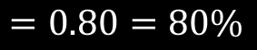
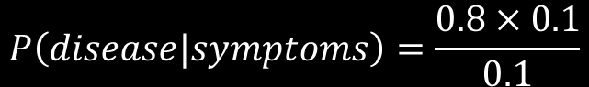
Generative Decision Making
Probability of mystery disease
Probability of red spotty rash
Probability of red rash for those with disease
$$P\left(disease\right)=0.1$$
$$P(symptom)=0.1$$
$$P\left(symptom|disease\right)=0.8$$
$$P\left(hypothesis|data\right)=\frac{P\left(data | hypothesis\right)×P(hypothesis)}{P(data)}$$
Bayes’ Theorem
$$P\left(disease|symptoms\right)=\frac{0.8×0.1}{0.1}$$
So the probability of having the mystery disease is 80%, if you have a red rash.
$$=0.80=80\%$$
Notes:
Lets consider an example of Generative decision making. We’re given some information regarding a disease, and then we’re asked to build a classifier that can predict if someone is afflicted or not.
The prevalence of the disease in the group of patients described by the prior probability. The prior probability can be read as meaning the probability the disease occurring, without knowing any additional information. This prior is equal to $0.1$which corresponds to 10%.
Suppose there is some symptom associated with the disease. The symptom is “red spotty rash”. The likelihood of having this symptom, irrespective of whether or not you have the disease, is 0.1 or 10%.
The likelihood of having this symptom, if afflicted with the disease, is given by the conditional probability. This can be read as, the probability of having the symptom, if afflicted by the disease. Here we see that 80% of the time, patients with the disease exhibit the symptom.
So far we have some basic information. But our classifier needs to determine if a patient has the disease, given some set of symptoms. How to do this? It will vary for each patient as each may have different symptoms.
Thankfully there is a famous formula known as Bayes’ Theorem, that allows us to calculate this. For now we’ll just use the theorem, but the notes contain resources that will help you understand it further.
We can plug in our probabilities and begin computing the answer.
We can see that if you have a red spotty rash, there is an 80% chance that you have the disease in question.

Slide 22
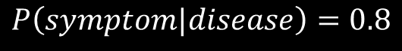
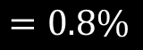
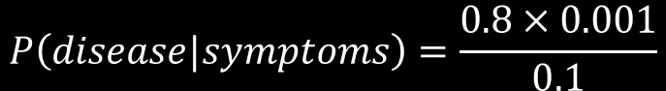
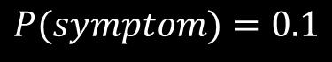
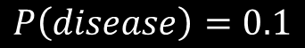
Generative Decision Making
Probability of mystery disease
Probability of red spotty rash
Probability of red rash for those with disease
$$P\left(disease\right)=0.1$$
$$P(symptom)=0.1$$
$$P\left(symptom|disease\right)=0.8$$
40 to 60 year old's
Mystery disease = Chicken pox!
$$P\left(disease\right)=0.001=0.1\%$$
This shows that the data used during training, must be representative of the data to be faced in the real-world.
$$P\left(disease|symptoms\right)=\frac{0.8×0.001}{0.1}$$
$$=0.8\%$$
We’ve actually just learned our next ML algorithm - Naïve Bayes. It makes predictions using probability.
Notes:
If the prior is updated, we get a very different estimate for the likelihood of the disease.
We’re given a new prior for a specific age group cover 40 to 60 year olds. The probability of the disease in this group is low, at 0.1%.
We can recompute our prediction using Bayes’ theorem. We find that for this new age group, the likelihood of having this disease, even in the presence of a red spotty rash, is extremely low at just 0.8%.
Perhaps this makes more sense if I tell you that the mystery disease is the common childhood ailment, Chicken Pox.
Generative learning can be used very effectively, so long as the data provided is unbiased, complete and not misleading.
It may not be obvious from this example, but such methods can be easily used to make predictions. All you have to do is couple the outputs of Bayes’ theorem, with an output threshold. For example, if the probability output by the theorem is greater than say, 70%, predict disease. Otherwise predict no disease.
We’ve actually just learned our next ML algorithm - Naïve Bayes. It makes predictions using probability in exactly this way. It learns by trying to find an optimal threshold over the output probability that achieves the minimum error rate.

Slide 23
Tree Learning – Discriminative Model
Suppose we have a dataset containing 2 classes:
Stars
Circles
Goal is the separate them as accurately as possible.
Non-linear model.
Successively discriminates into classes via partitioning the data.
Each partition forms an extra decision boundary.
Key question – which feature to split on at any given time?
4.
Pure
2.
3.
1.
6.
1/1
4/4
5.
Notes:
Suppose we have a dataset containing 2 classes:
Stars
Circles
Our goal is the separate them as accurately as possible.
One way to do this, is the expand on the idea of the decision stump. Suppose we combine multiple stumps. This would allow us to combine multiple linear boundaries.
We can see the first boundary has partitioned the data into circles and stars using some feature. Now we can add another stump to the previous to create a second boundary.
The second boundary lets us create two separate regions in the data. But our stump no longer looks like it did before – it’s acquiring more of a tree-like structure.
We continue to add stumps, partitioning the data further.
With the addition of the 4th stump, we achieved something interesting. We’ve now created two pure regions in the top left of the plot. These regions are pure because they contain only 1 type of class. This means in this area; the new stump is now perfectly separating circles and stars. It achieves 100% accuracy on both.
We can keep adding more stumps.
With each addition, we able to better separate the data.
This way of learning, which involves recursively adding stumps together is known as tree learning. The combined system is known as a Decision Tree.
As you can see from the diagram, decisions trees are non-linear models. This is because they can produce non-linear separators.
Decision trees successively discriminate labelled training data into classes via partitioning.
Each partition forms an extra decision boundary.
To build Decision Trees there are some key questions to answer. Which feature should each stump split upon? What split value should be used for each feature? How deep should the tree be allowed to go?

Slide 24

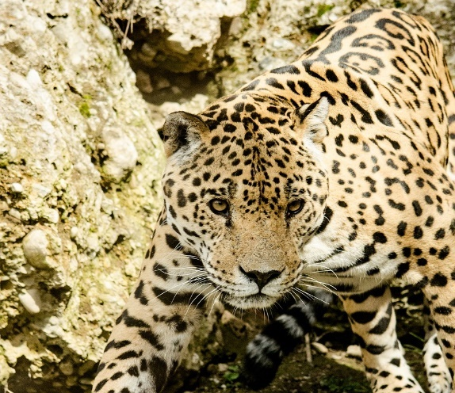
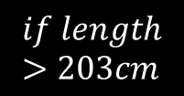
Tree Split Choice
Feature 1. Distribution
Feature 2. Distribution
Feature 3. Distribution
At each spilt point, find the feature that maximises the separation between each class.
Done by considering the statistical distribution of the features.
Via an optimisation method (search over the possible split-points, find the best).
$$if length>203cm$$
Mountain Lion
Mass roughly equal
Jaguar
Notes:
At each spilt point, decision trees find the feature that maximises the separation between the classes in the data.
This is done by considering the statistical distribution of the features. The aim is the find a distribution that exhibits ”separability”. What does this mean? Well, we have three feature distributions shown in the top left of the slide. These distributions show the probability of a feature value occurring, for both the circle and star classes.
Feature 1’s distribution is fairly separable. Hence the probability distributions for the circle and star classes don’t overlap much. You can see that a linear separator easily fits between them.
The distributions for features 2 and 3 show much more overlap. They are not as separable. Of the three features, we choose the best feature for the first stump.
Just because the first feature was the most separable for the first stump, doesn’t mean it will be for the second. Or for the third. Each time a new tree split is considered, all features are revaluated again for separability.
Perhaps you’ll understand why if you think back to the probability we introduced for Naïve Bayes. Feature 1 works well for the first split, as without any additional information, it is the best separator.
But now as we move further down the tree, our decisions can be conditioned on previous steps. An example may help.
Suppose we want to split Felines into their respective families.
The best separator at first, is mass. It allows us to efficiently split house cats form Tigers, Lions, Jaguars etc. However, some species of large cat are of similar size.
At this level trying to split Jaguars from Mountain Lions on mass won’t work, as these distributions greatly overlap.
At this stage in the decision making process, a feature such as length is more useful, because this has greater separability given what we already know – that these two types of animal are similar in terms of mass.
Decision trees search for the best feature and best feature split-point, via a mathematical optimisation method. This searches for the parameters that yield the lowest error rate.
Additional Notes:
A link with a tutorial on probability distributions: https://www.analyticsvidhya.com/blog/2017/09/6-probability-distributions-data-science/

Slide 25
Splitting Guided by Error
Threshold with max separability
Density
Value
Errors
Threshold Value
Notes:
We can visualise how this works. As we try different split point values, we impact the error rate. As we start to approach the optimal spilt point, the error rate drops off.
If we keep going past the optimal value, then we’ll start encountering more errors again.

Slide 26
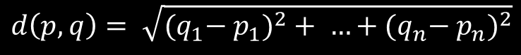
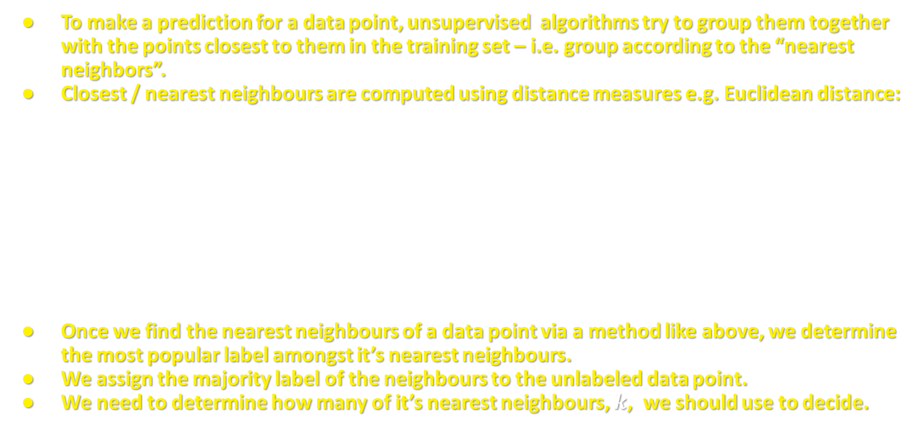
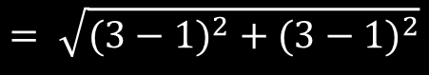
Unsupervised learning
To make a prediction for a data point, unsupervised algorithms try to group them together with the points closest to them in the training set – i.e. group according to the “nearest neighbors”.
Closest / nearest neighbours are computed using distance measures e.g. Euclidean distance:
Once we find the nearest neighbours of a data point via a method like above, we determine the most popular label amongst it’s nearest neighbours.
We assign the majority label of the neighbours to the unlabeled data point.
We need to determine how many of it’s nearest neighbours, $k$, we should use to decide.
$$y$$
$$(3,3)$$
$$d\left(p,q\right)= \sqrt{{{(q}_{1}− p_{1})}^{2}+ …+{{(q}_{n}− p_{n})}^{2}}$$
$$q$$
$$= \sqrt{{(3−1)}^{2} +{ (3−1)}^{2}}$$
$$p$$
$$(1,1)$$
$$= \sqrt{{(2)}^{2} + {(2)}^{2}} = \sqrt{4+4}=2.828 to 3.d.p$$
$$x$$
Notes:
To make a prediction for an unlabelled data point, unsupervised algorithms first group them together with the points closest to them in the training set – i.e. group according to the “nearest neighbours”.
Closest / nearest neighbours are computed using distance measures e.g. the Euclidean distance:
The Euclidean distance is easy to compute once you understand the background. Here we can see two points represented in a 2-d ”Euclidean” plane. Each point can be represented by a set of coordinates. In particular, coordinates corresponding to their position on the $x$-axis, and position on the $y$-axis. The point $p$ sits at position 1 on the $x$ axis and position $1$ on the $y$-axis. These coordinates can be written as $(x,y)$ pairs that your already familiar with.
There is a formula that enables you to compute the Euclidean distance between two points. We can just treat this as a black box, plug in some values, and compute distances as required.
In this example we can easily compute the distance between $p$ and $q$.
Click
The distance is around 2.828 to three decimal places. Note that I’ve provided links in the notes that will help you understand these concepts more clearly.
Once we find the nearest neighbours of a data point via a method like above, we determine the most popular label amongst it’s labelled nearest neighbours.
We assign the majority label of the neighbours to the unlabelled data point.
We just need to determine how many of it’s nearest neighbours, 𝒌, we should use to decide.

Slide 27

$K$-nearest Neighbours
k=7
k=5
k=3
?
K value | Prediction
3
5
7
Notes:
We have some data containing two classes, circles and stars. We start out with two stars, and one circle described. We also have a new data point, represented by the question mark. It is unlabelled . However using the k-nn approach, we can assign a likely label.
To do this we assign the unknown point the majority label of it’s 3 nearest neighbours.
Thus we predict star as the likely label for $k=3$.
If we increase the number of neighbours under consideration to 5, things change. Now the majority label of the 5 nearest neighbours is circle.
Thus we predict circle as the likely label for $k=5$.
If we again increase the number of neighbours to 7, things change once more. Now the majority label of the 7 nearest neighbours is star again.
Thus we predict star as the likely label for $k=7$.
This approach is simple, but it has proven very effective for numerous real-world problems.
As you will discover, finding the best value for $k$ is a trial and error process.

Slide 28
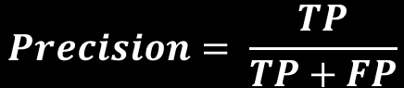
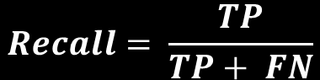
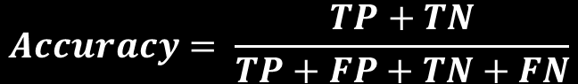
Evaluation
Irrelevant items
not retrieved (TN)
By counting the outcomes, we can evaluate performance. To do this we use “metrics” that quantify performance.
Classified as “star”
Target
True Positives (TP)
$$Accuracy= \frac{TP+TN}{TP+FP+TN+FN}$$
False Negatives (FN)
False Positives (FP)
$$Recall= \frac{TP}{TP+ FN}$$
True Negatives (TN)
$$Precision= \frac{TP}{TP+FP}$$
Relevant items
not retrieved (FN)
Irrelevant items
retrieved (FP)
Relevant items
retrieved (TP)
Many, many more metrics!
Notes:
Let’s visualise the evaluation of machine learning algorithm.
Suppose we have a labelled test dataset consisting of stars and circles as shown.
The stars are the target items enclosed by the yellow dashed circle. We want to separate stars and circles, but only because we’re trying to find stars.
The white circle with a shaded region represents those examples some classifier has labelled as stars.
This central region, where the two circles overlap, contains the relevant items that the classifier has correctly identified in the test set.
These are known as, “True Positives”.
The left most region of the yellow circle, not covered by the shaded area, contains relevant items that were not “retrieved”. These represent errors. Here the classifier has predicted circle, when it should have predicted star.
Such mistakes are known as “False Negatives”.
The right most region of the white circle, that doesn’t overlap with the yellow circle, contains irrelevant items that were “retrieved”. These represent errors. Here the classifier has predicted star, when it should have predicted circle.
Such mistakes are known as “False Positives”.
The remaining examples are the irrelevant items not retrieved. That is, the classifier correctly predicted circle for these items.
These are known as, “True Negatives”.
By counting the outcomes, we can evaluate performance. To do this we use evaluation “metrics”.
These include accuracy ,Recall and Precision.
To test our algorithms we must evaluate them using useful metrics. In machine learning we use standard metrics during evaluation. Accuracy is the most easily understood metric, and is sometimes a good indicator of performance. But there are many more metrics. Here I simply introduce the three most common, along with a visual explanation for how they are derived.

Slide 29
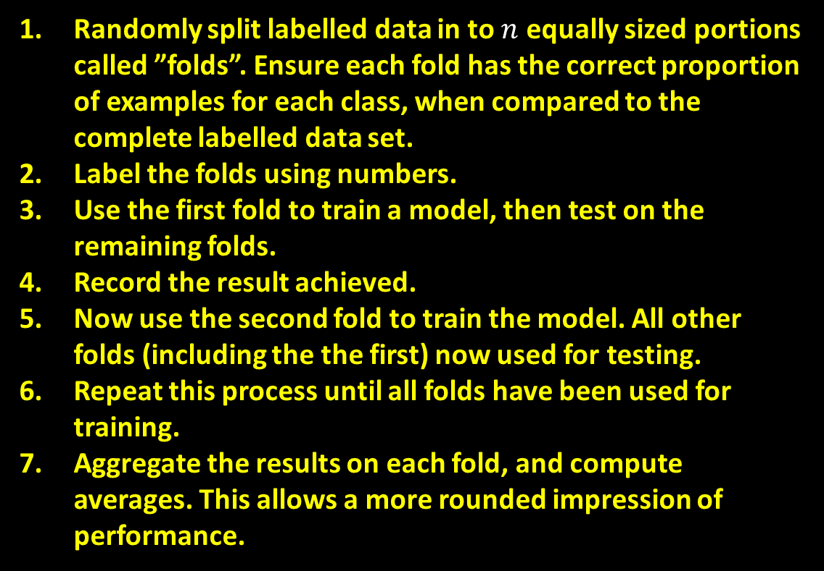
Practical Evaluation
1
2
Randomly split labelled data in to $n$ equally sized portions called ”folds”. Ensure each fold has the correct proportion of examples for each class, when compared to the complete labelled data set.
Label the folds using numbers.
Use the first fold to train a model, then test on the remaining folds.
Record the result achieved.
Now use the second fold to train the model. All other folds (including the the first) now used for testing.
Repeat this process until all folds have been used for training.
Aggregate the results on each fold, and compute averages. This allows a more rounded impression of performance.
Train
Test
Train
Test
8
3
Test
Test
Test
Test
Test
Test
Test
Test
7
4
Test
Test
Test
Test
6
5
N-fold Stratified
Cross Validation
Notes:
Suppose we have the following labelled dataset containing two classes. We want to use it for training and testing. However we want to do this in a robust way, and we don’t want our results to be overly specific to any training/test split that we may choose. So how to proceed.
First we randomly split the labelled data in to $n$ equally sized portions called ”folds”. We ensure each fold has the correct proportion of examples for each class, when compared to the complete labelled data set. So if the ratio of stars to circles is 50:50 in the complete data set, each fold should maintain this ratio.
Label the folds using numbers.
We then use the first fold to train a model, and test on the remaining folds. In this case we train on 1 fold and test on 7.
Record the result achieved for the first test.
Now use the second fold to train the model. All other folds (including the first) are now used for testing.
Repeat this process until all folds have been used for training.
Aggregate the results on for each training fold, and compute averages. This allows a more rounded impression of performance.
This process is known as N-fold Stratified Cross Validation.

Slide 30

Summary of Process (1)
Re-design
Features
Example | $$feature 1$$ | $$feature 2$$
$$x_{1}$$ | 7.4 | 29
$$x_{2}$$ | 6.6 | 24
$$x_{3}$$ | 3.1 | 11
… | … | …
$$x_{n}$$ | 0.5 | 2
Training
Test Data
Collect Data
Design / Extract
Evaluate
Notes:
Let’s summarise the main phases involved in the application of machine learning.
First we collect our data. This step may require data normalisation, data cleaning, data labelling, or even removing personal details according to ethics requirements. Whatever the exact steps are, we should end up with a dataset ready for learning. There should be enough samples in the data set to enable it to be split into disjoint training, and test sets. The data should be representative of the concepts we’re trying to learn, and we should aim to minimise the potential for bias where possible.
The next step involves feature design and extraction. This involves designing features for the data, that we believe will help us achieve accurate classification results. If we’re given a dataset of animal pictures, we can extract many possible features, e.g. has legs, number of legs, number of eyes, colour, size etc.
After you’ve designed the features you must extract them from the dataset, and evaluate them. You can evaluate features by quantifying their information content. Some features have higher information content than others, whilst a subset of features may reveal previously hidden information when combined with seemingly unrelated features. In both cases it’s good to evaluate the features to discover these relationships.

Slide 31
Summary of Process (2)
Training
Test Data
New Data
$$f(x)$$
$$f(x)$$
$$f(x)$$
$$z$$
Predictions
Predictions
Build
Evaluate
Deploy
Notes:
Once the features have been evaluated, you can use them to start exploring which machine learning methods work best for your problem. It is desirable to try different types of learning models, evaluating their performance. Choose a model, and train it.
Evaluate the trained model on separate test data set - ensure the performance is still good. If it isn’t, try a different algorithm. Repeat this exploration phase until performance is satisfactory.
When satisfied that the machine learning model works well, then you can finally deploy it upon new data.

Slide 32
Python

Slide 33
Types of Languages
There are two different types of coding language:
“Low Level” Languages
Hard for humans to read.
Easy for machines to read.
Can be processed efficiently by CPUs.
Often written in binary or simple numerical format.
Can be used to control specific parts of the CPU.
The total lines of code required to do simple tasks can become very large!
“High Level” Languages
Easy for humans to read.
Hard for machines to read.
Cannot be processed efficiently by CPUs.
Often written using a combination of human language and numbers.
The total lines of code required to do simple tasks is small!
Human language is after all more expressive.
Notes:
There are two different types of coding language:
There are “Low Level” Languages:
Hard for humans to read.
Easy for machines to read.
Can be processed efficiently by CPUs.
Often written in binary or simple numerical format.
Can be used to control specific parts of the CPU.
If you add up the number of lines of code required to complete a task in a low-level language, this total can become very large!
There are “High Level” Languages:
Easy for humans to read.
Hard for machines to read.
Cannot be processed efficiently by CPUs.
Often written using a combination of human language and numbers.
If you add up the number of lines of code required to complete a task in a high-level language, this total can be very small.
Human language is after all more expressive.

Slide 34
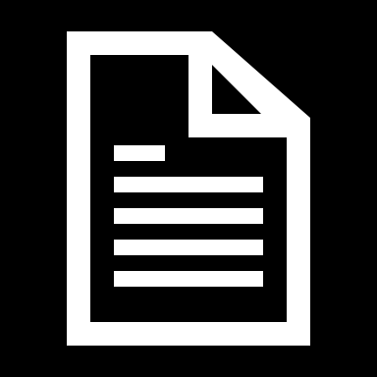
Translating to Machine Code
Machine code clearly doesn’t need translating for the CPU to understand it.
All other programming languages must be translated. There are two main approaches for doing this.
Compiled
Interpreted
Written code
Written code
Compiler
Interpreter
Executable machine
code file
Executable machine
code file
Notes:
Machine code clearly doesn’t need translating for the CPU to understand it.
All other programming languages must be translated. There are two main approaches for doing this.
Some computer programming languages are known as compiled. For each type of CPU, a tool called a compiler is created, that understands its machine code. When you write a piece of code, it is stored in a source code file. This file is then passed to the compiler. The compiler goes through the code file line by line, and translates it to machine code. This produces an executable file, that a CPU can run.
Some computer programming languages are known as interpreted. For each type of CPU, a tool called an interpreter is created, that understands its machine code. When you write a piece of code, it is stored in a source code file. This file is then passed to the interpreter. The interpreter goes through the code file line by line, and translates it to machine code. This produces an executable file, that a CPU can run. Interpreted languages are special, in that they can interpreted on the fly. That is, you don’t need to interpret an entire source code file to create machine code. You can interpret single lines of code as you write them if needed.

Slide 35
Python
Python is an interpreted programming language.
When you run Python code in code academy, a python interpreter reads each line, converts it to machine code, and this is run by the CPU.
You’ve been learning Python 3. Thus, you’ve been using an interpreter capable of translating Python 3 code to machine code.
Programming languages improve over time. If you wrote code Python 2 code, a Python 3 interpreter would not understand it. Thus ,you’d get errors.
What’s important to understand here:
Python is interpreted, you therefore need an interpreter to run Python code.
You must use an interpreter that understand the code your writing.
Any computer with a suitable Python interpreter will be able to run your code.
Notes:
Python is an interpreted programming language.
When you run Python code in code academy, a python interpreter reads each line, converts it to machine code, and this is run by the CPU.
You’ve been learning Python 3. Thus, you’ve been using an interpreter capable of translating Python 3 code to machine code.
Programming languages improve over time. If you wrote code Python 2 code, a Python 3 interpreter would not understand it. Thus, you’d get errors. I suppose it would be a little like writing a book in Shakespearean English, and expecting a modern English speaker to understand it perfectly.
What’s important to understand here:
Python is interpreted, you therefore need an interpreter to run Python code.
You must use an interpreter that understands the code your writing.
Any computer with a suitable Python interpreter will be able to run your code.

Slide 36
To the Colab!

Slide 37
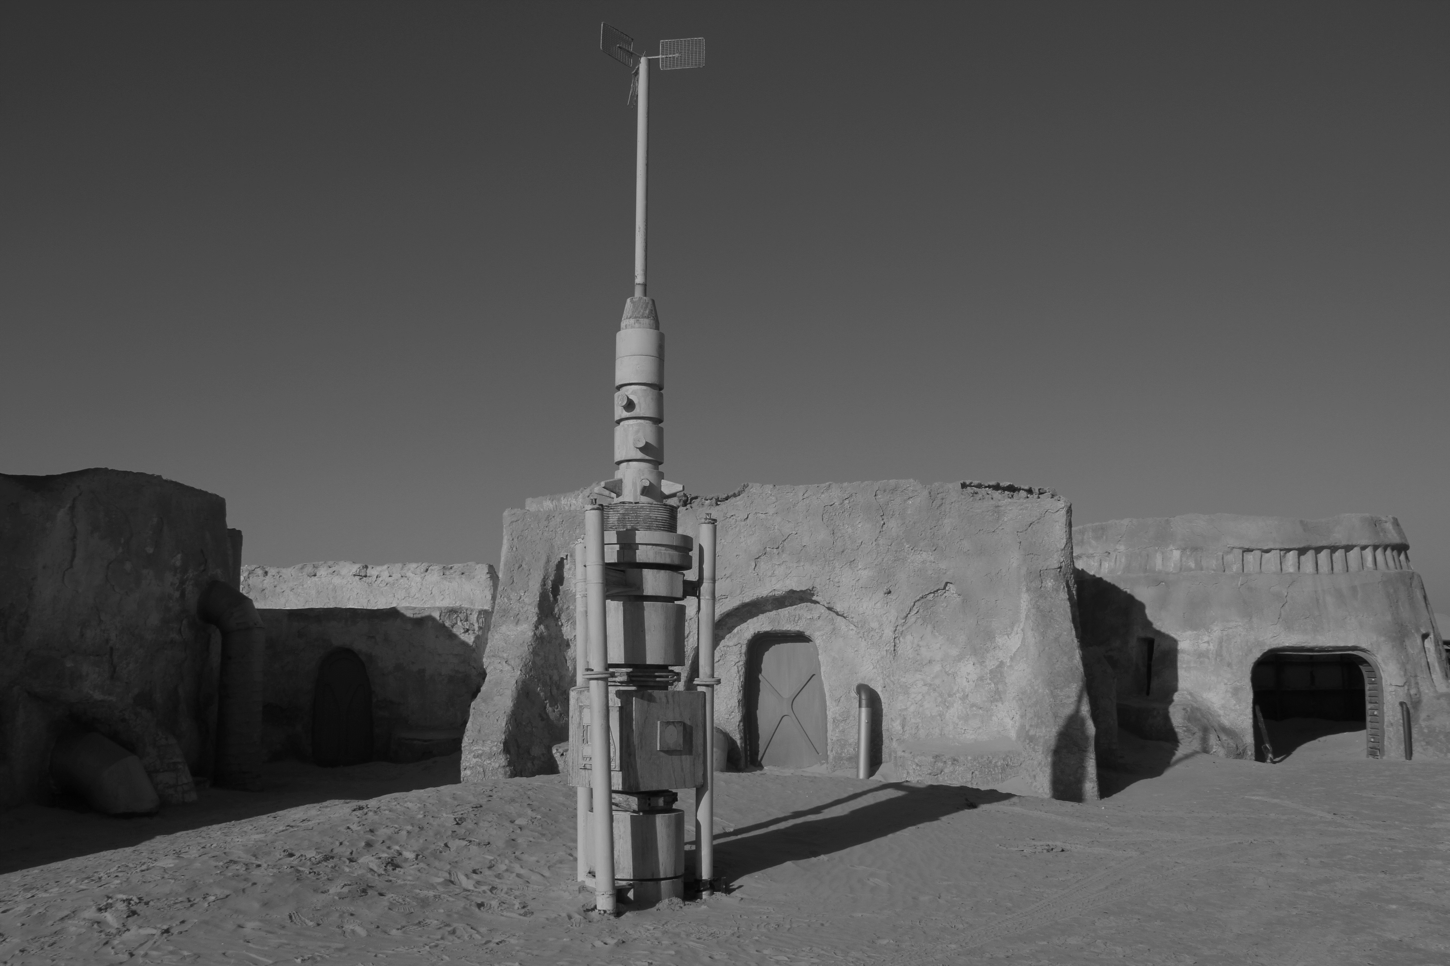

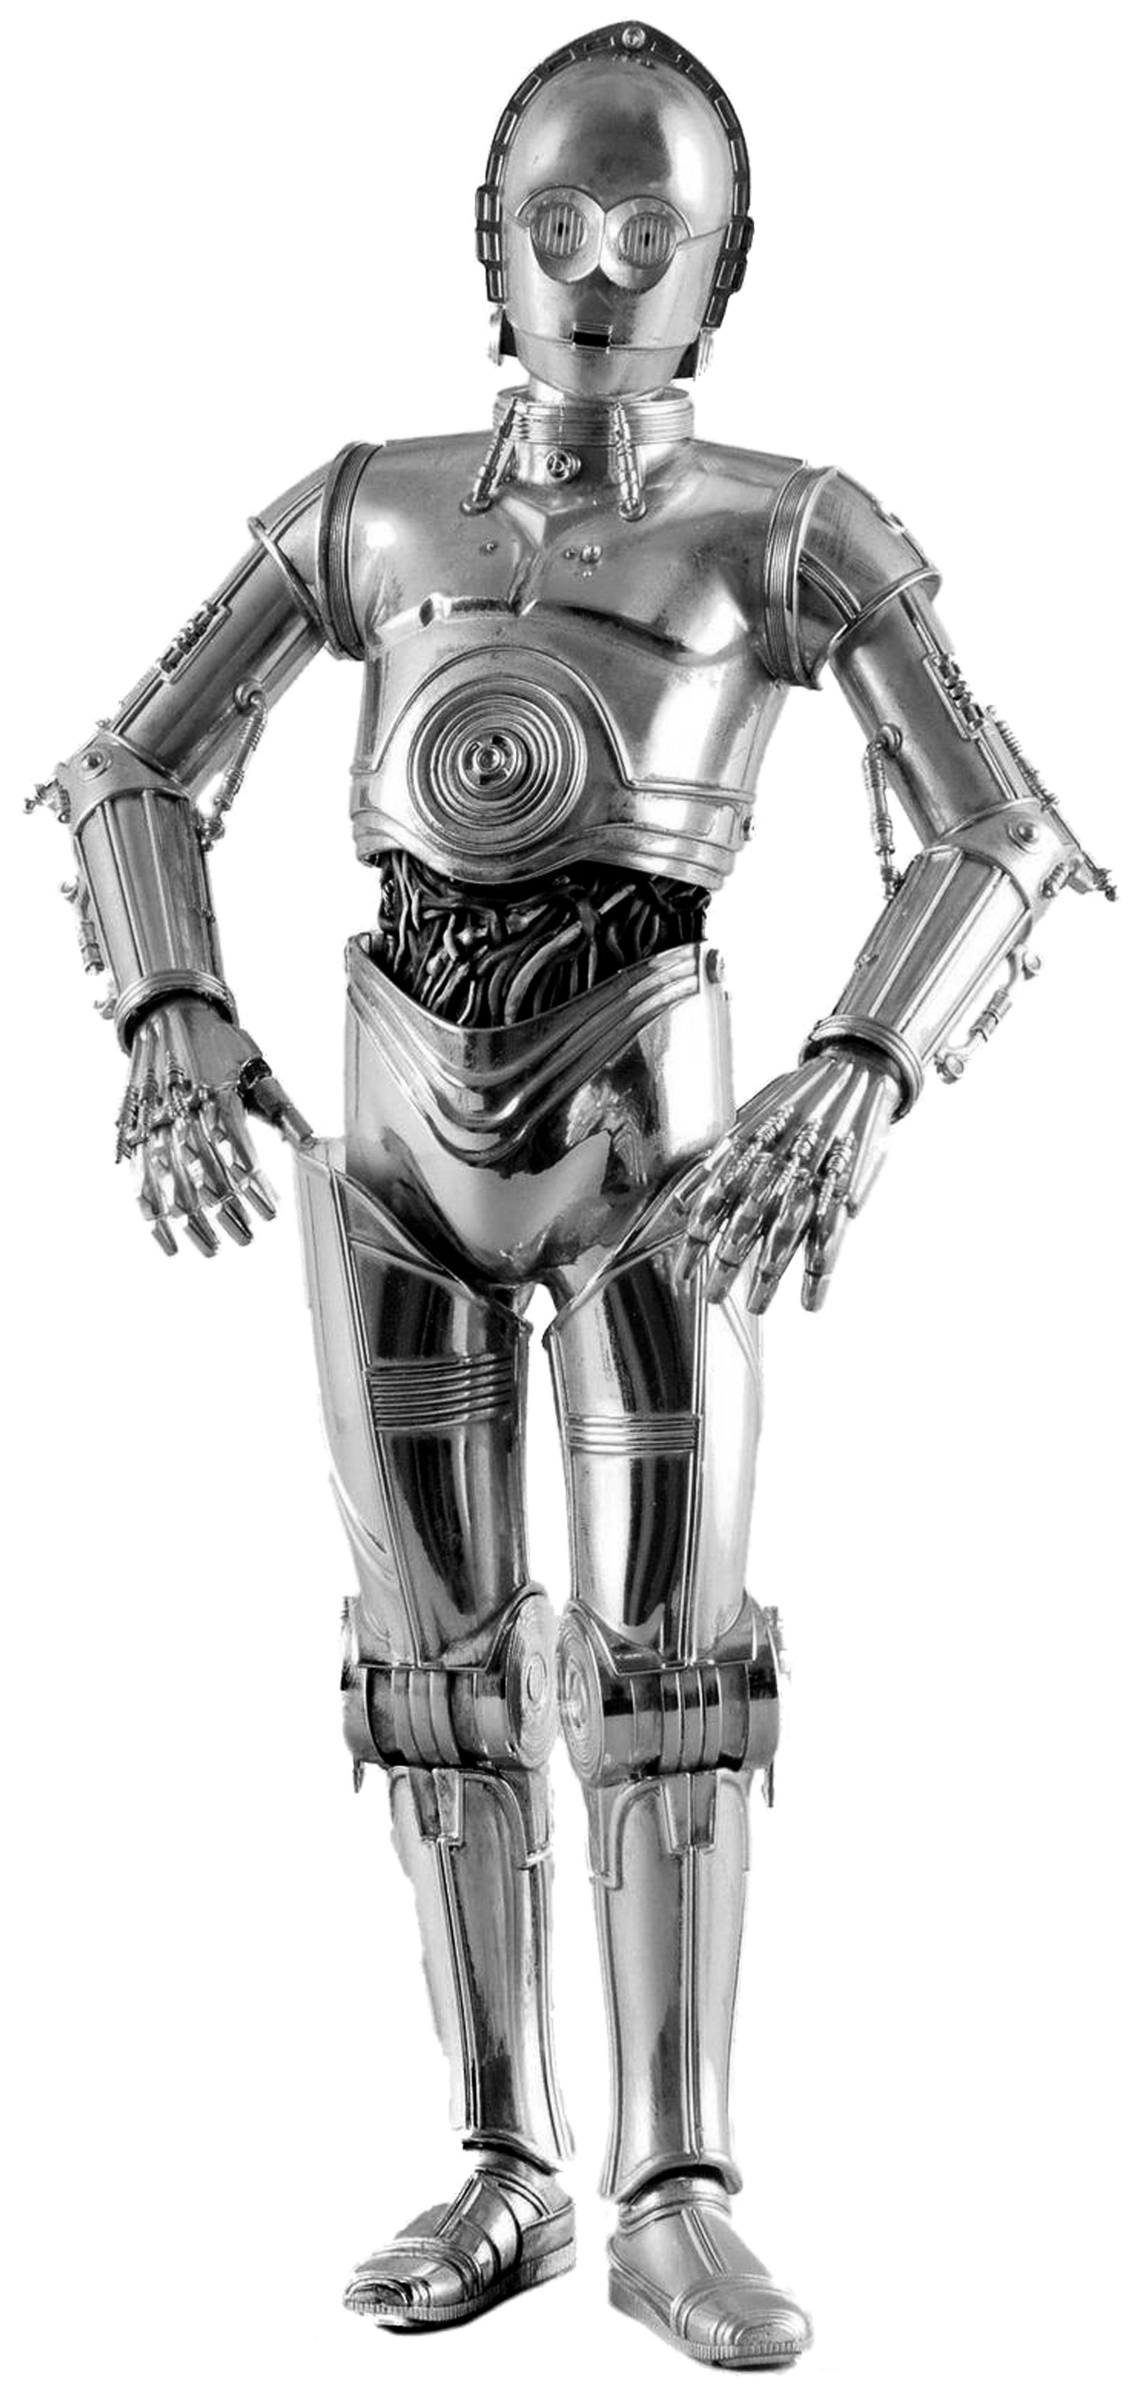
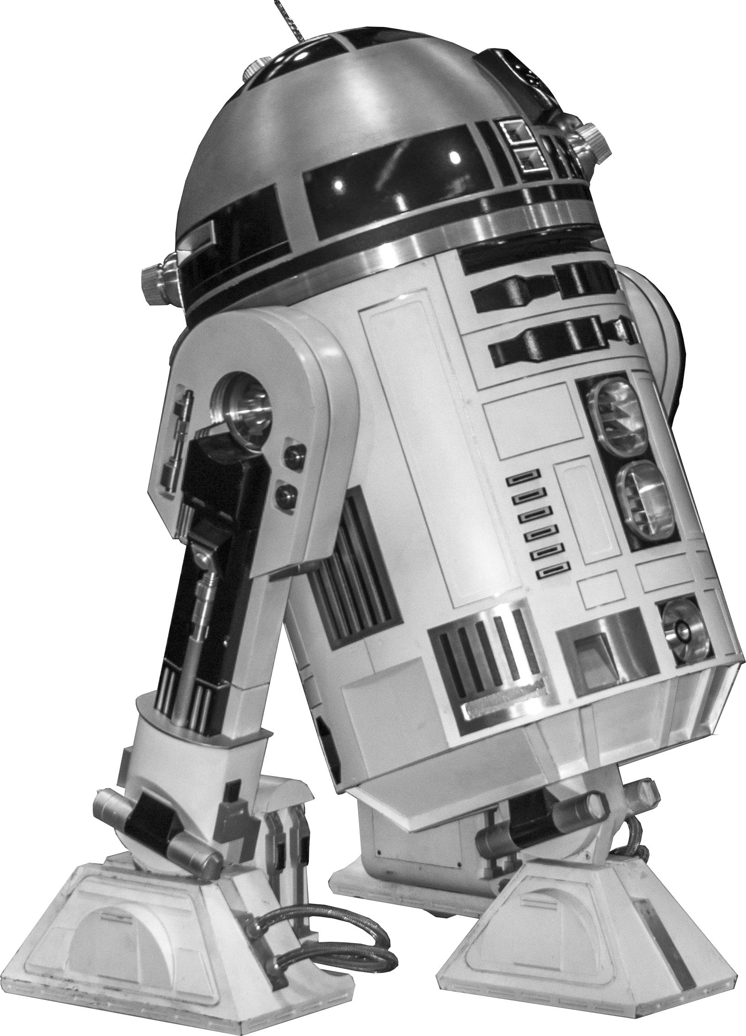
Questions & Thank For Listening
@scienceguyrob
robert.lyon@edgehill.ac.uk
Acknowledgements
Uncredited images obtained from https://pixabay.com (Creative Commons License, no attribution required).
More Information:
https://github.com/scienceguyrob/AI4AstroMasterclass

